Slide 1
Peter Micheuz, Alpen-Adria-University Institut für Informatiksysteme
Peter.micheuz@uni-klu.ac.at
Reflections on Software Tools in Informatics Teaching

Slide 2
Peter Micheuz, Alpen-Adria-University Institut für Informatiksysteme
Peter.micheuz@uni-klu.ac.at
http://click7.org/image-mosaic-generator/
Reflections on Software Tools in Informatics Teaching

Slide 3
Peter Micheuz, Alpen-Adria-University Institut für Informatiksysteme
Peter.micheuz@uni-klu.ac.at
http://click7.org/image-mosaic-generator/
http://animations.funphotobox.com
Reflections on Software Tools in Informatics Teaching

Slide 4
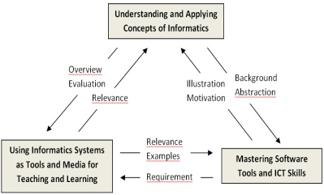
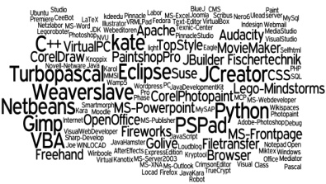
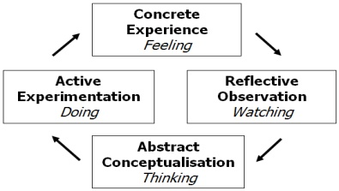
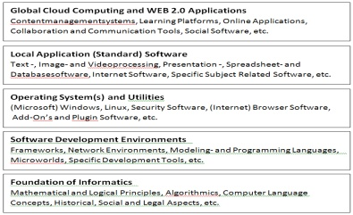
What is this Short Communication about?
Introduction : Software in Context
Part I : An Austrian Case Study Part II : Tools and/or Concepts Part III : Ontology – Classification
Future Work

Slide 5
The computer is …
an abstract machine
versatile medium
a concrete tool
Synthesis of Informatics Education, Hubwieser

Slide 6
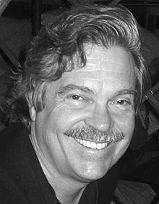
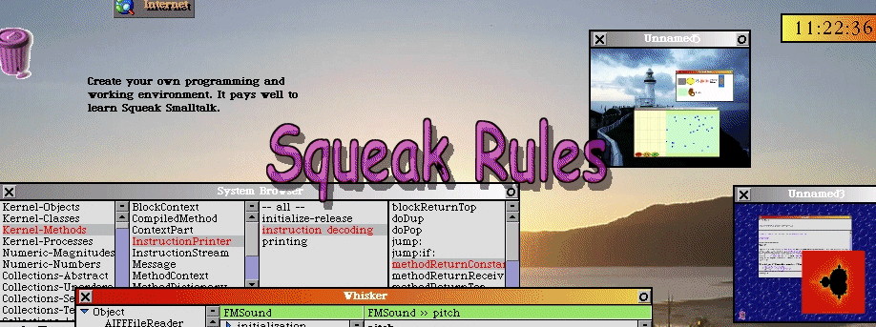
The Computer is a medium. I always thought it as a tool, a much weaker concept.
The best way to predict the future is to invent it.

Slide 7
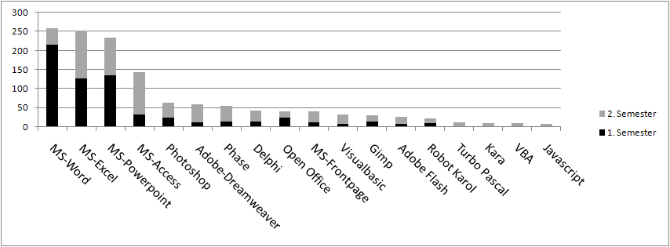
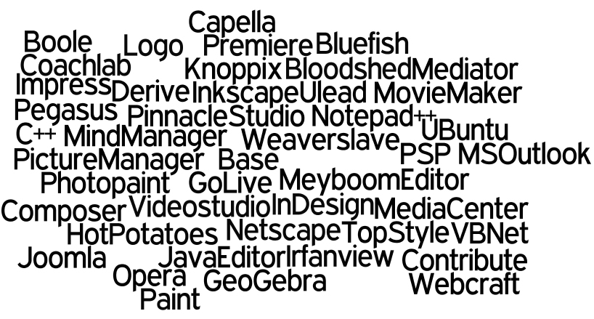
Use of Software Tools in the 9th Grade (age 15)
n = 400

Slide 8
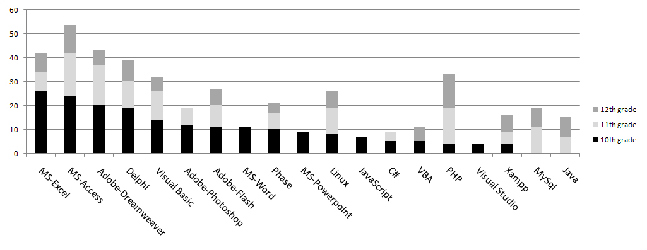
Use of Software Tools in the 10th – 12th Grade
n = 100
n = 400

Slide 9
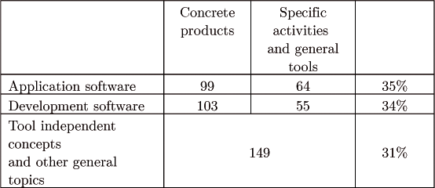
Proposals for In-Service Training by the Teachers
Allocation of the Teachers' proposals - categories

Slide 10
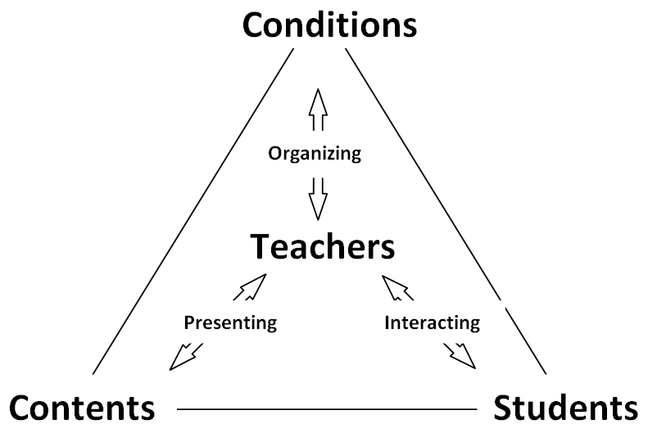
Fundamental Didactics Questions: Who/What do we teach in Informatics? Pupils or/and Subject [Individuals or/and Objects]
How do we teach Informatics? Brand / Product [Word ™ = Text Processing] or Concept Driven? [Practice or/and Theory]
Process Model of Classroom Management
Theory without practice is empty;
Practice without theory is blind.“
Immanual Kant
Practice without Theory is blind,
Theory without practice is sterile
Karl Marx
Practice without theory is dangerous,
but theory without practice is madness".
Mao-Tse-Tung
Software Tools
Concepts
Scherler, 2004

Slide 11
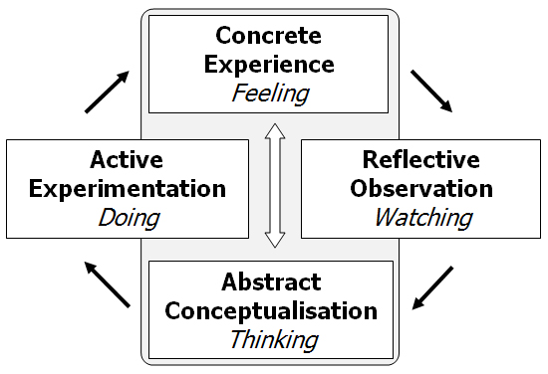
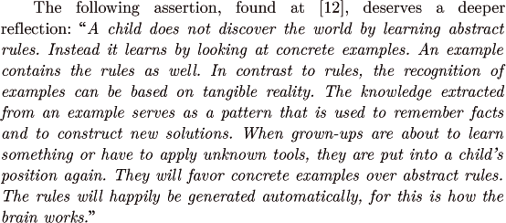
Teaching Tool-Based Skills, Knowledge and Concepts
Kolb's Learning Styles
Kühne, 1999

Slide 12
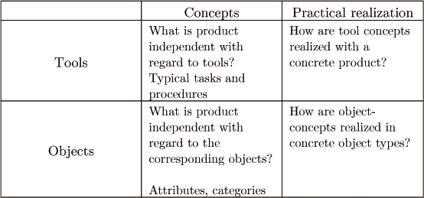
A Generic Model of Tools (abstract class)
Hartmann, 2006
A Practical Example (concrete object)

Slide 13
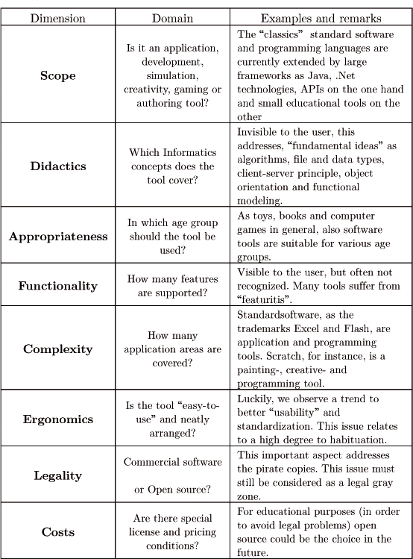
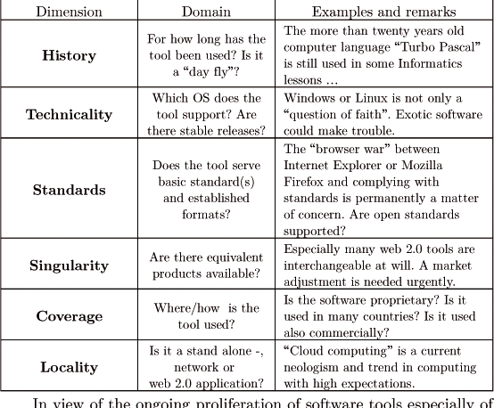
A (Theoretical) "Useless?" Endorsement … „A Tool-Ontology“
Towards a Classification Scheme for Software (Tools)
WWW  WWC

Slide 14
We all have become tools of our tools …
Coping with affluent software (tools ) will get a prevalent future challenge.
We all have become tools of our tools …
Any Questions?

